Slide 2
Cyber-physical Test Benches Remotely Controlled via Internet
Workshop as part of the MYiTOPS project
Nicht vergessen: du bist der Moderator! Du leitest die Themen ein und lässt sie aber von den Teilnehmern erarbeiten!

Slide 3
Workshop is divided into three blocks
Fist day: Presentation and Group Work
Morning: State of Technology Digitalisation
Definition of Digitalisation
Cyber-physical Systems
Open-Source and GitHub
Internet and Cyber Security
Group Work + Discussion about results
Afternoon: Technical requirements HS-UMT
Test benches and System controlling
Sensor/Actor Interfaces
Network / Internet
Groub Work + Discussion about results
Second day (Morning): Practical Introduction
introduction github
Set up Cyber-physical system RPI
Set up Network and Server with Labview
06.11.17
| 3

Slide 4

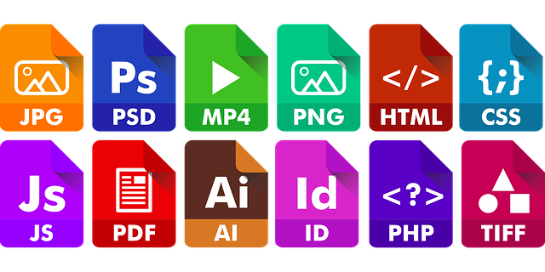

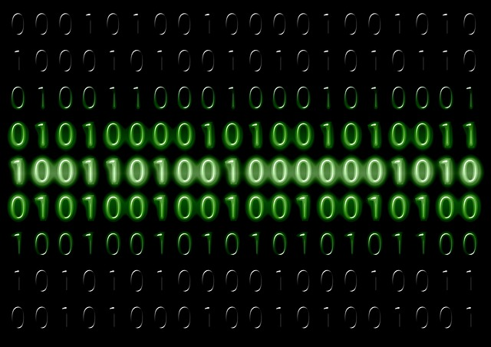
Definition of Digitalisation
… is the process of converting information into a digital (i.e. computer-readable) format, in which the information is organized into bits… The result is called digital representation or, more specifically, a digital image, for the real object…[1, 2]
Digital transformation
Information of the Cat…
“Real World”
Object
“Digital World”
Object
Converting…
Notes:
The Digit-Cat can used to understand Cats, the e-book can used to read the content!

Slide 5
Examples of established digitisation or digital services today
Email
E-Commerce
Navigation Systems
Streaming
Language Assistants

Slide 6
What is particularly important in digitisation?
Form of the data are bits and bytes
Data exchange via a fast and efficient Internet or local Network
Computers and servers are required to process the data
Input and output medium are smartphones, intelligent refrigerators, autonomous cars, smart robots ...

Slide 7
Digitisation is bringing with it so many major changes that it is seen as the new industrial revolution.
Industry 4.0 is commonly referred to as the fourth industrial revolution.
These revolutions and evolutions include:
IoT (Internet of Things)
Cloud Computing
Big Data
Smart Home
Connected Car
Predictive Maintenance
Smart Energy
Smart City
3D-Printer
AI (Artificial Intelligence)
Blockchain
Crypto Currencies
Fintech (Financial Technology)
Virtual Reality

Slide 8
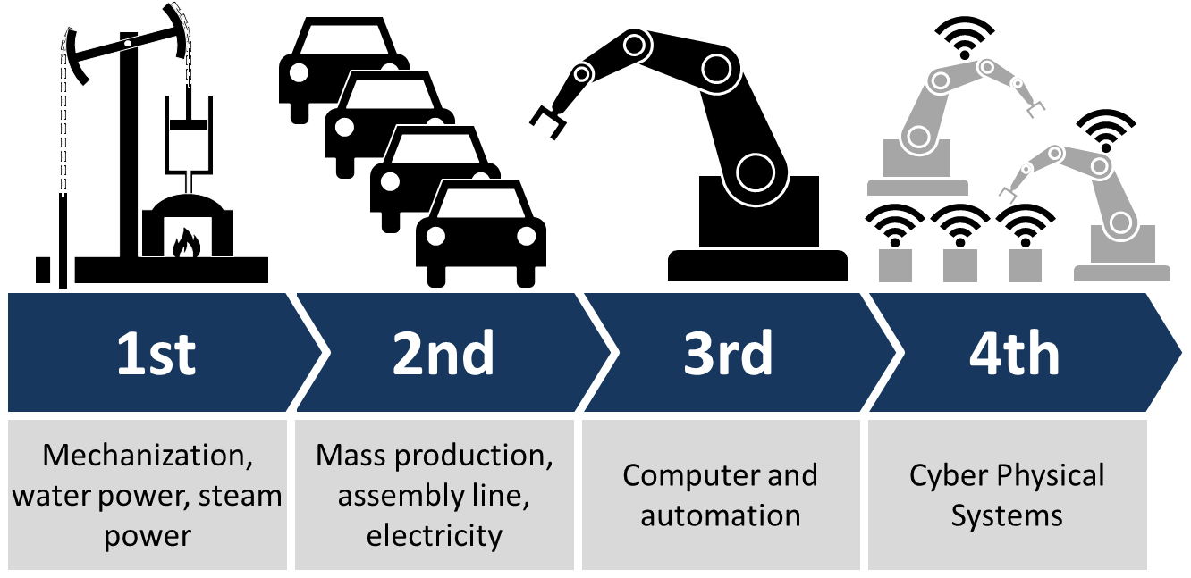
Conversion of the real information into digital? How?
Industrial revolutions and future view [2]

Slide 9
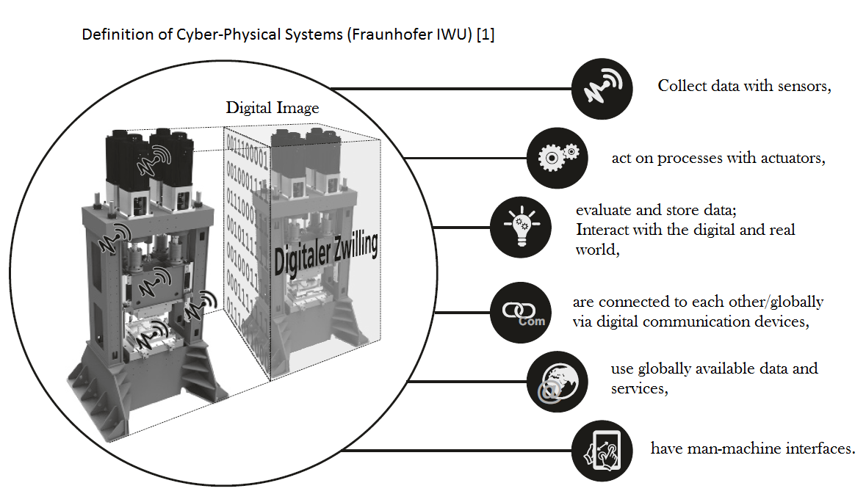

Slide 10
What is particularly important in cyber-physical systems (CPS)?
A cyber-physical system represents the desired unity of reality and digital image.
A further development of the mechatronics to a symbiotic system approach on the basis of information technology.
Sensory, actuatorial and cognitive functions can be integrated into technical systems.
Networkability of all components

Slide 11
They form the basis for fascinating perspectives of technical systems [3]:
Functionalities that have so far only been fulfilled by biological systems:
autonomous systems: These systems independently solve complex tasks within of a particular application domain.
dynamically networked systems (System-of-Systems): The degree of system networking will increase.This will result in new, more complex systems, their functionality and performance exceeds the sum of the individual systems.

Slide 12
Interactive socio-technical systems: Opens up new perspectives on the interaction between human beings and the Machine. The systems will flexibly adapt to the needs of the user.
Product service systems: The result product service systems, which are based on a close intermeshing of material and process services and customer-focused problem solving. Skillful Combinations of innovative services and intelligent systems form the basis of the Basis for innovative business models .

Slide 13


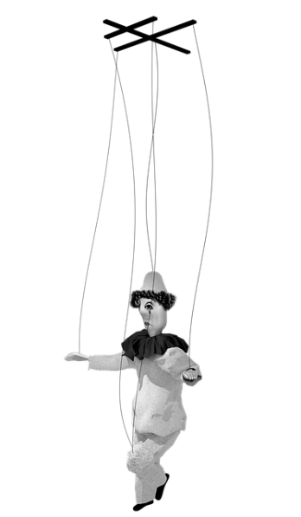
Acquisition and Control
Converting to
digital image…
Controlled via data …
Transfer digital data …
Data controlled
cyber-physical
system
Data acquisition via a cyber-physical system

Slide 14
Division into three working groups for each question: processing time 15 min and presentation of the results 10 min for each group.
Group 1:
What is meant by industrial revolution?
Group 2:
What advantages are expected in industry?
Group 3:
How can we use the digitalization and CPSs for our goals?
Notes:
Tafel -> saving time, location-independent cooperation, project management, Monitoring development, Coordination of tasks, Scientific added value

Slide 15
Lunch Break… see you soon…

Slide 16
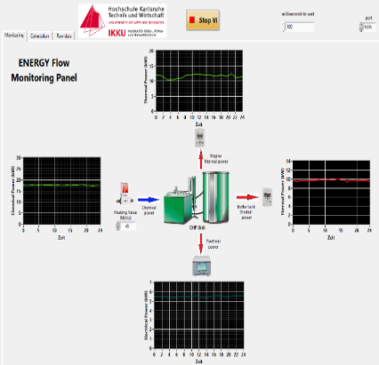
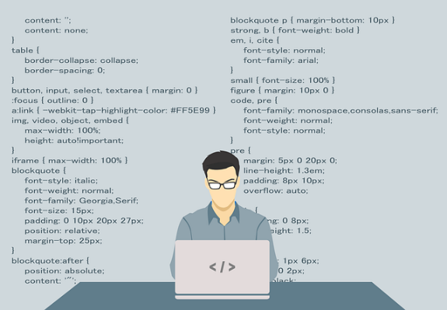
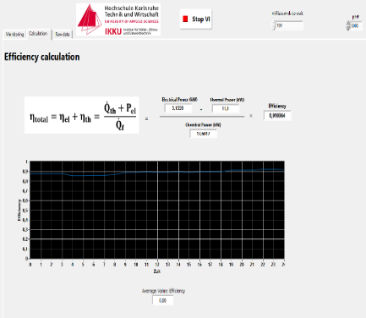

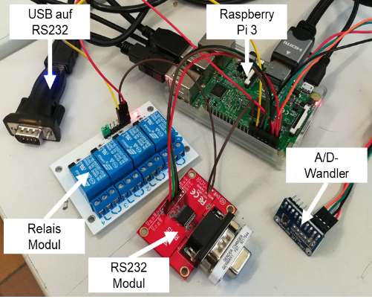
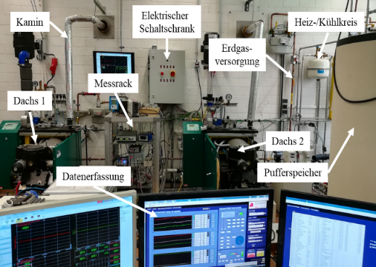
Digitisation of Test Benches?
“Digital World” Object(s)
Management
Converting…
“Real World” Object(s)
06.11.17
| 13

Slide 17
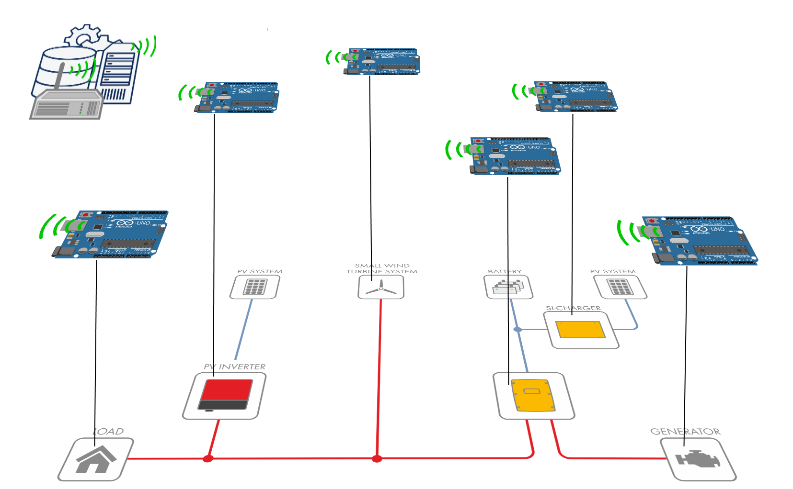
Digitisation of (Energy) Systems?
Cyber-physical Systems!
Combination of computer and software components with mechanics and/or electronics as well as networking of the components with each other.
Digital Image or
Digital Abstractions
of the Energy System
Cyber-physical
Objects (CPOs)
Infrastructure of
Regulation of
energy flows
Definition: Arbeitskreis Industrie 4.0
Quelle: Fraunhofer IESE, iese.fraunhofer.de/de/innovation_trends/industrie4_0.html, SMA.de
06.11.17
| 17

Slide 18
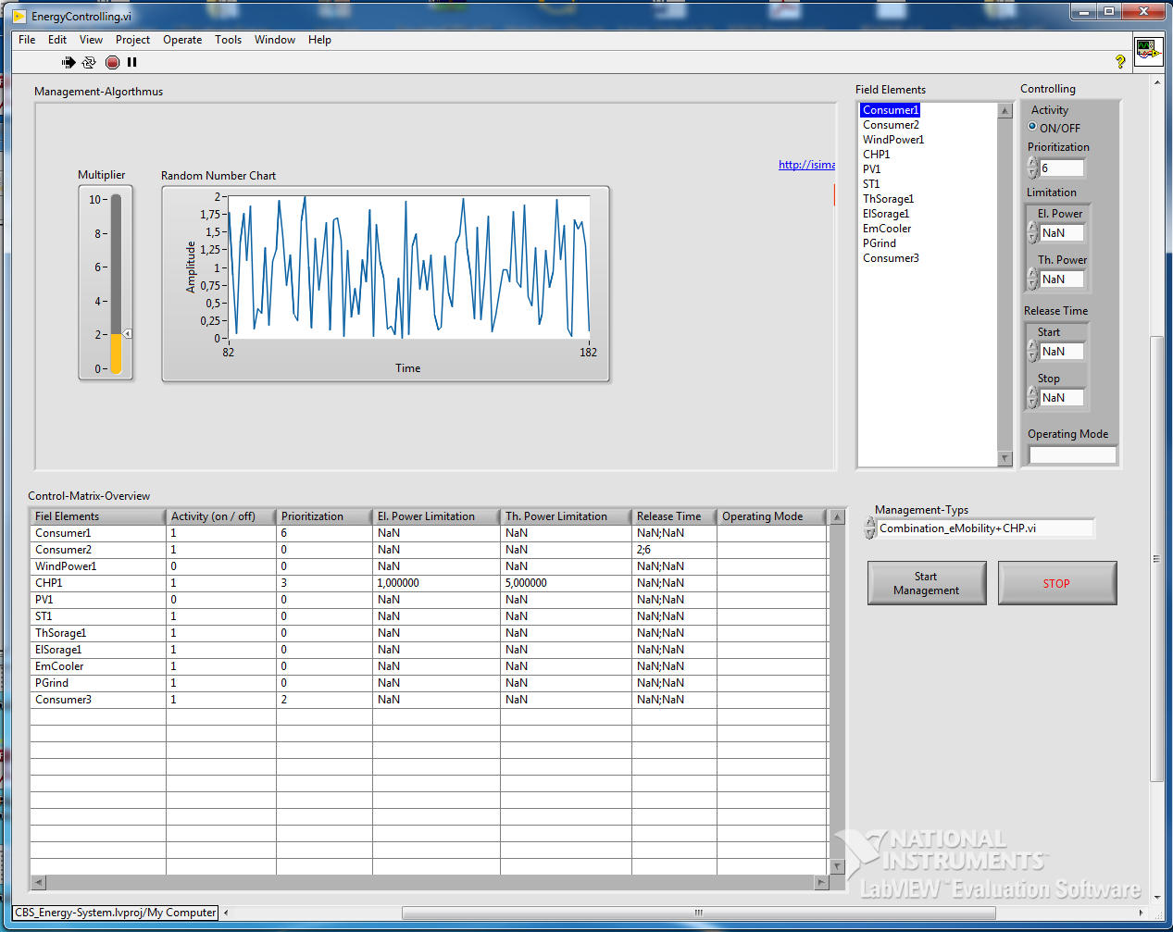
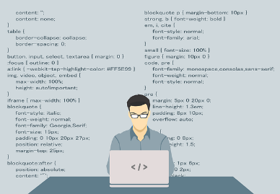
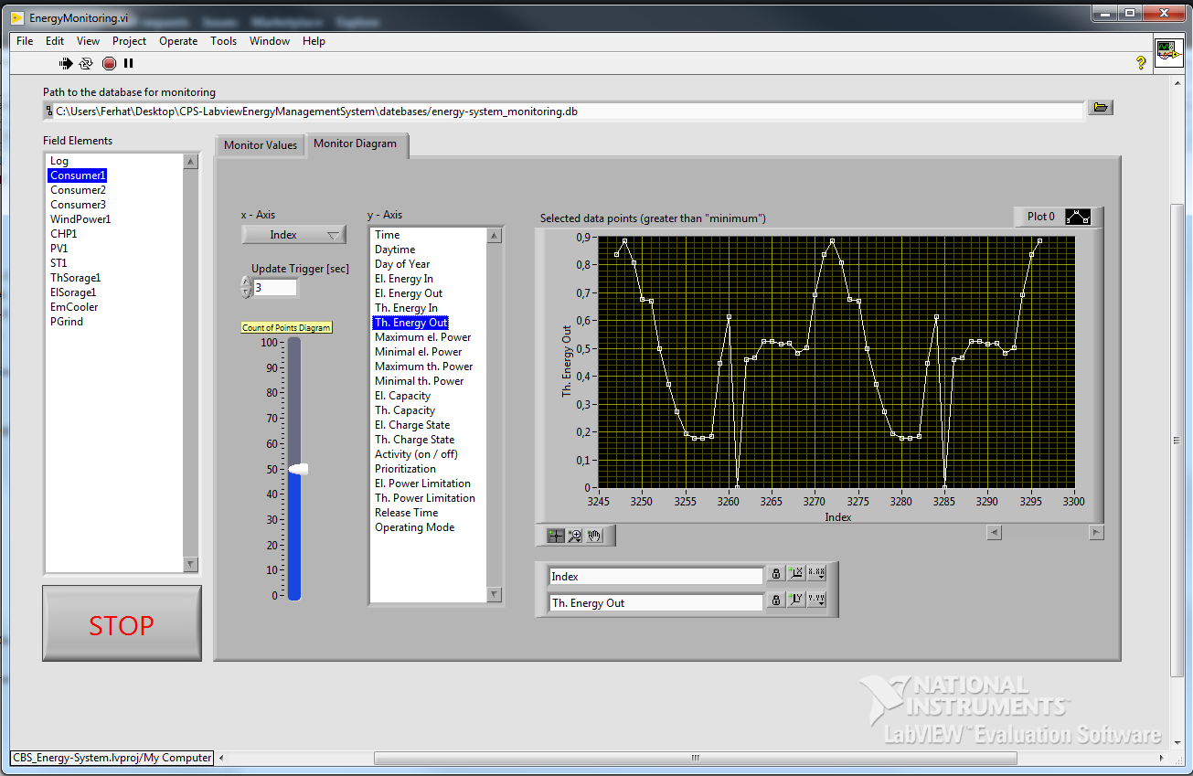
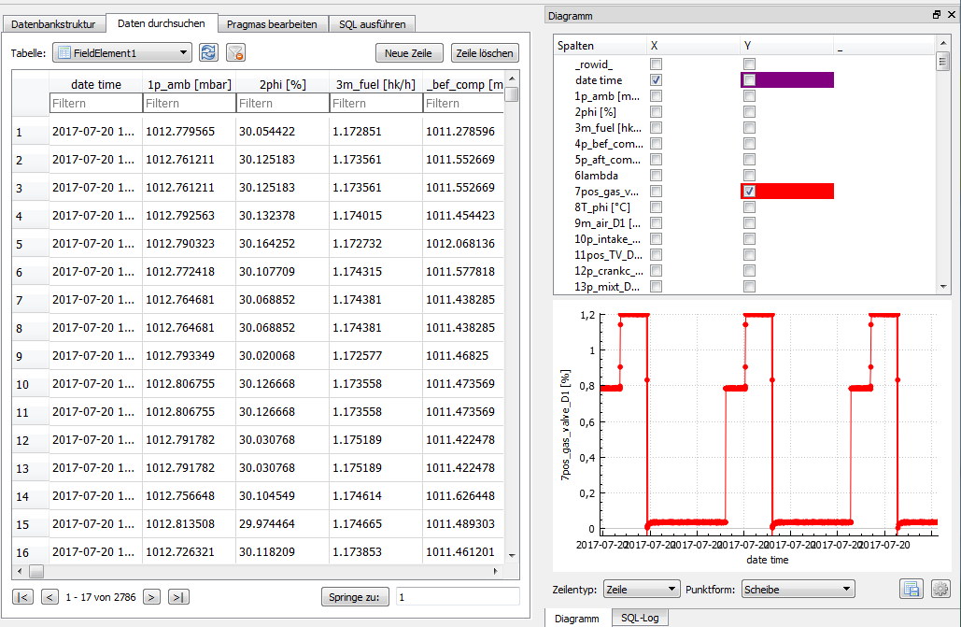


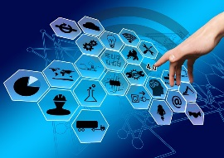

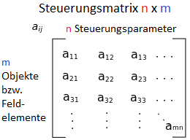
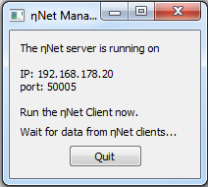
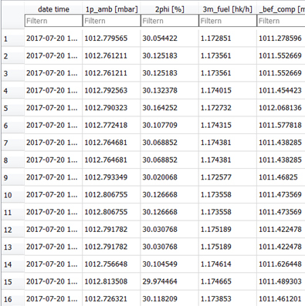
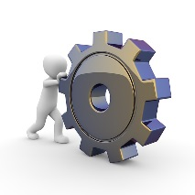
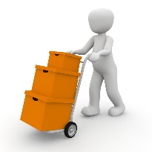
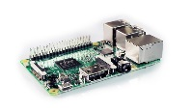
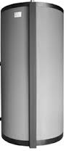


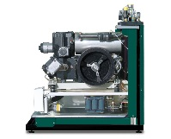
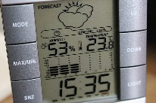
OOP-oriented Programming Paradigm
Management Interface
Monitoring
Abstraktion und Digitalisierung der Anlage
Schnittstelle für die Managementschicht und der CPOs
Handler
Data Collector
Projekt MYiTOPS (gefördert von BWS plus mit 110 000 Euro)
Doppelabschluss-programme (Bachelor)
Cyber-Physical Objects
Producer
Consumer
Storage

Slide 19
Opens different possibilities:
Design of the visualization and usability of energy flows of combined heat and power units (CHPs) on a touch screen.
Integration of weather data
Conception of the management of BHKWs for the eMobility (charging station)
Development and integration of an electrical storage device
Control of test benches and energy systems via the Internet

Slide 20
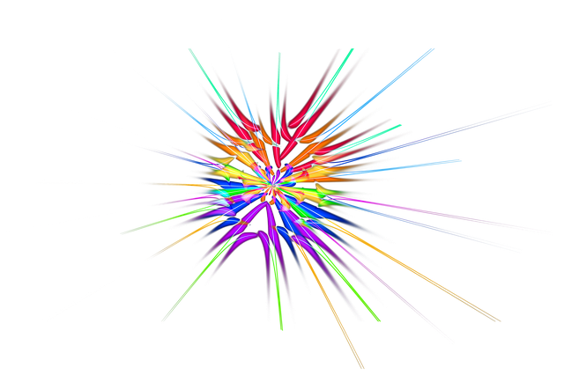
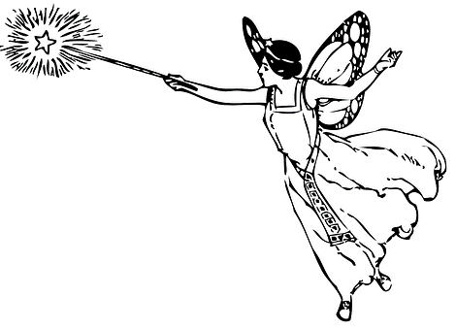


How can we work together in the future?

Slide 21
What is GitHub?
It lets you and others work together on projects from anywhere.
What do I have to do to use GitHub?
When would you want to learn it?
What can I do?
Notes:
Tafel -> saving time, location-independent cooperation, project management, Monitoring development, Coordination of tasks, Scientific added value

Slide 22

Software Publications
https://github.com/IKKUengine/SimulatedCPSLabVIEWEnergySystem (LabVIEW)
https://github.com/IKKUengine/CHPefficiency (Python)
Will follow soon:
https://github.com/IKKUengine/SingleServerCHPefficiency (LabVIEW)
https://github.com/IKKUengine/ThreadedEtaNetServer (C++/Qt5.8)
https://github.com/IKKUengine/CPOEtaNetClient (C++/Qt5.8)
GitHub.com/ikkuengine

Slide 23
Dankeschön…
Contact
Ferhat Aslan
Institut für Kälte-, Klima- und Umwelttechnik
Tel.: 0721 925-1815
Raum M-U07
E-Mail: ferhat.aslan@hs-karlsruhe.de
Prof. Dr.-Ing. Maurice Kettner
Fakultät für Maschinenbau und Mechatronik
Tel.: 0721 925-1845
Raum F-111
E-Mail: maurice.kettner@hs-karlsruhe.de

